Slide 1

Brief Idea
User can share information of item costs from different supermarkets and locations.

Slide 2
Brand name
Item name
Item cost
Supermarket – sheng siong, fairprice, cold storage, giant
Location – Shopping mall, commercial building, HDB etc.
Address – exact location of the supermarket
Info Provided By - username

Slide 3
Entity Relationship (ER) Diagram
Date
Day
Cost
Username
1
M
ItemCost
M
1
Supermarket
M
M
Location
M
M
1
1
M
1
Item
M
1
Brand
Address

Slide 4
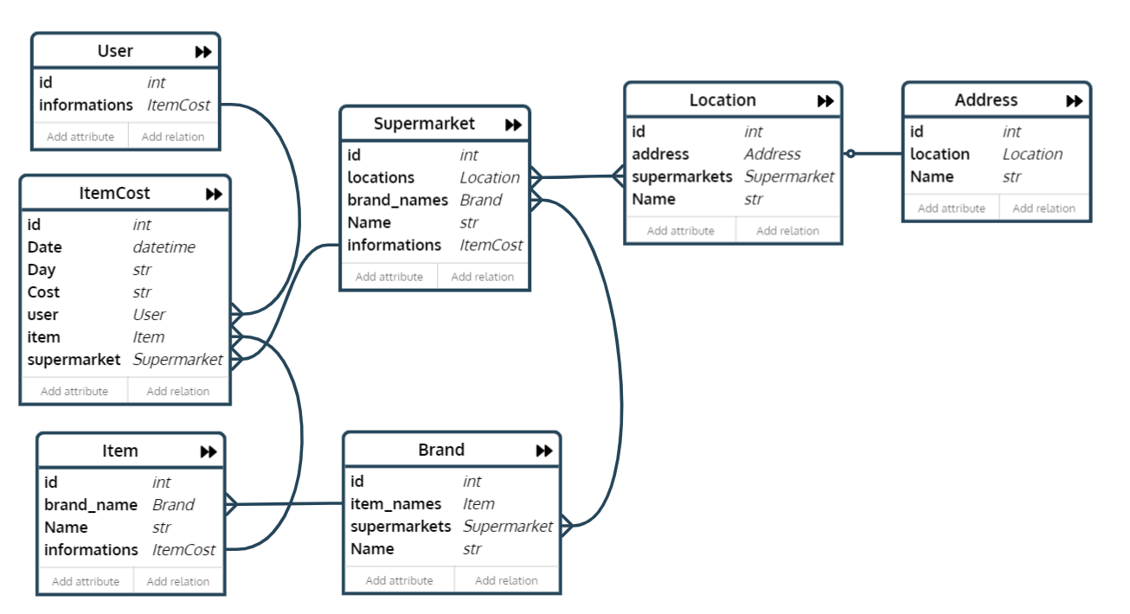
Logic Diagram
https://editor.ponyorm.com/user/arifrawi/SupermarketPriceSharing/designer

Slide 5
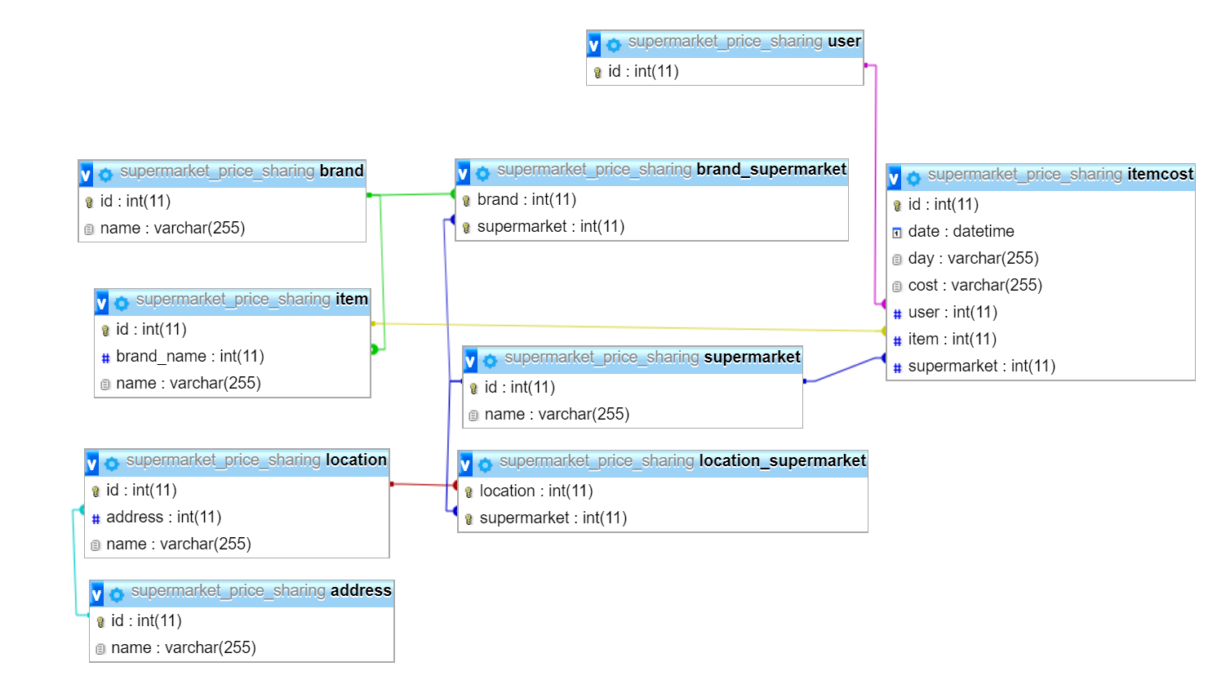
PHPMyAdmin

Slide 6
Latest updates
Lowest prices now
Lowest prices the past months

Slide 7
P
RICE
S
HARE

Slide 8
Attribute
Action
Entity
M

